Slide 1

Natural Language Processing

Slide 2

Agenda
Definition
Why nlp
NLP Task
Tools and approach
NLP Usecases

Slide 3
definition
Natural language processing (NLP) refers to the branch of computer science—and more specifically, the branch of artificial intelligence or AI—concerned with giving computers the ability to understand text and spoken words in much the same way human beings can.
NLP combines computational linguistics—rule-based modeling of human language—with statistical, machine learning, and deep learning models. Together, these technologies enable computers to process human language in the form of text or voice data and to ‘understand’ its full meaning, complete with the speaker or writer’s intent and sentiment.

Slide 4
NLP challenges
NLP faces various challenges, including language ambiguity, understanding context, handling different languages, and training models on large amounts of data. Additionally, ethical considerations such as bias and privacy need to be addressed in NLP application.

Slide 5
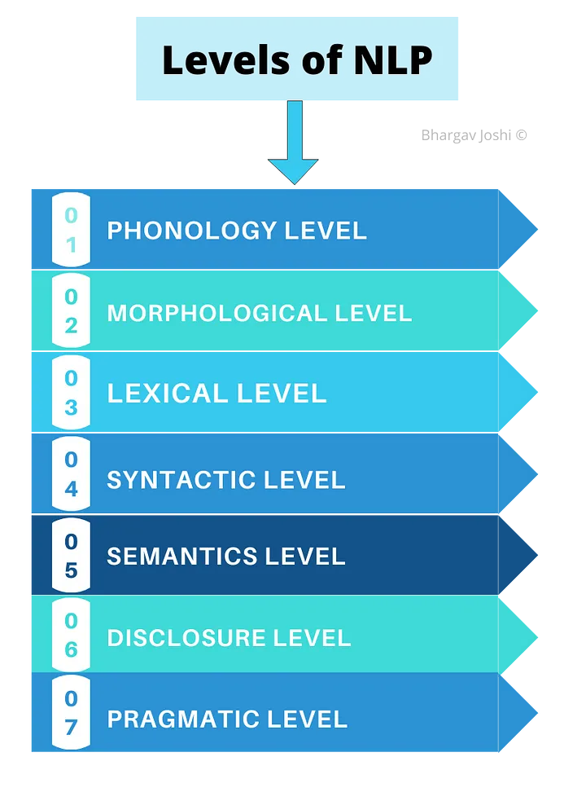
At this level basically, it deals with pronunciation.
It deals with the interpretation of speech sound across words
It deals with the smallest words that convey meaning and suffixes and prefixes.
This deals with the study at the level of words with respect to their lexical meaning and Part of speech (POS)
This level deals with the grammar and structure of sentences
This level deals with the meaning of words and sentences
This level deals with the structure of different kinds of text.
This level deals with the use real world knowledge and understanding of how this influences the meaning of what is being communicated.

Slide 6
NLP TASK
Some of these tasks include the following:
Speech recognition, also called speech-to-text, is the task of reliably converting voice data into text data. Speech recognition is required for any application that follows voice commands or answers spoken questions. What makes speech recognition especially challenging is the way people talk—quickly, slurring words together, with varying emphasis and intonation, in different accents, and often using incorrect grammar.
Part of speech tagging, also called grammatical tagging, is the process of determining the part of speech of a particular word or piece of text based on its use and context. Part of speech identifies ‘make’ as a verb in ‘I can make a paper plane,’ and as a noun in ‘What make of car do you own?’

Slide 7
NLP TASK (1)
Word sense disambiguation is the selection of the meaning of a word with multiple meanings through a process of semantic analysis that determine the word that makes the most sense in the given context. For example, word sense disambiguation helps distinguish the meaning of the verb 'make' in ‘make the grade’ (achieve) vs. ‘make a bet’ (place).
Named entity recognition, or NEM, identifies words or phrases as useful entities. NEM identifies ‘Kentucky’ as a location or ‘Fred’ as a man's name.
Co-reference resolution is the task of identifying if and when two words refer to the same entity. The most common example is determining the person or object to which a certain pronoun refers (e.g., ‘she’ = ‘Mary’), but it can also involve identifying a metaphor or an idiom in the text (e.g., an instance in which 'bear' isn't an animal but a large hairy person).

Slide 8
NLP TASK (2)
Sentiment analysis attempts to extract subjective qualities—attitudes, emotions, sarcasm, confusion, suspicion—from text.
Natural language generation is sometimes described as the opposite of speech recognition or speech-to-text; it's the task of putting structured information into human language.

Slide 9
NLP tools & Approaches
Python and the natural language toolkit (NLTK)
The Python programing language provides a wide range of tools and libraries for attacking specific NLP tasks. Many of these are found in the Natural Language Toolkit, or NLTK, an open source collection of libraries, programs, and education resources for building NLP programs.
You can find more information about NLTK at https://www.nltk.org/

Slide 10
Text processing
Tokenization, process of dividing text into individual units call tokens.these tokens can be words, phrases, or characters depending on the specific task at hand.
Stop words removal, stopwords are common words that do not carry much meaning, such us “and”, “the”, or “is”. This procedure helps reduce noise in the text.
Stemming, reducing words to their base or root form kown as the stem
Lemmatization, similar to stemming, but it aims to reduce words to their dictionary or canonical form, known as the lemma.

Slide 11
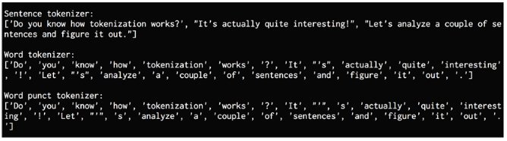
Tokenizing text data
When we deal with text, we need to break it down into smaller pieces for analysis. To do this, tokenization can be applied. Tokenization is the process of dividing text into a set of pieces, such as words or sentences. These pieces are called tokens. Depending on what we want to do, we can define our own methods to divide the text into many tokens. Let's look at how to tokenize the input text using NLTK.

Slide 12
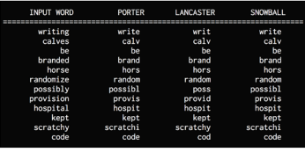
_{Stemming}
Working with text means working with a lot of variation. We must deal with different forms of the same word and enable the computer to understand that these different words have the same base form. For example, singer, singing, song, sung, and so on. This set of words share similar meanings.
Stemming is a way of producing morphological variants of a root/base word. Humans can easily identify these base forms and derive context. When analyzing text, it's useful to extract these base forms. It is basically a heuristic process that cuts off the ends of words to extract their base forms. Let's see how to do it using NLTK.

Slide 13
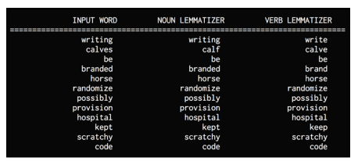
lemmatization
Lemmatization is another method of reducing words to their base forms. In the revious section, we saw that some of the base forms that were obtained from those stemmers didn't make sense. Lemmatization is like stemming, but it brings context to the words. So, it links words with similar meanings to one word.
The lemmatization process uses the lexical and morphological analysis of words. It obtains the base forms by removing the inflectional word endings such as ing or ed. This base form of any word is known as the lemma. If you lemmatize the word calves, you should get calf as the output. One thing to note is that the output depends on whether the word is a verb or a noun. Let's look at how to do this with NLTK.

Slide 14
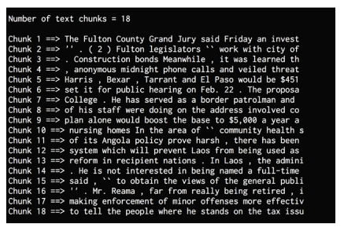
Dividing text data into chunks
Text data usually needs to be divided into pieces for further analysis. This process is known as chunking. This is used frequently in text analysis. The conditions that are used to divide the text into chunks can vary based on the problem at hand.
This is not the same as tokenization, where text is also divided into pieces. During chunking, we do not adhere to any constraints, except for the fact that the output chunks need to be meaningful. When we deal with large text documents, it becomes important to divide the text into chunks to extract meaningful information.

Slide 15
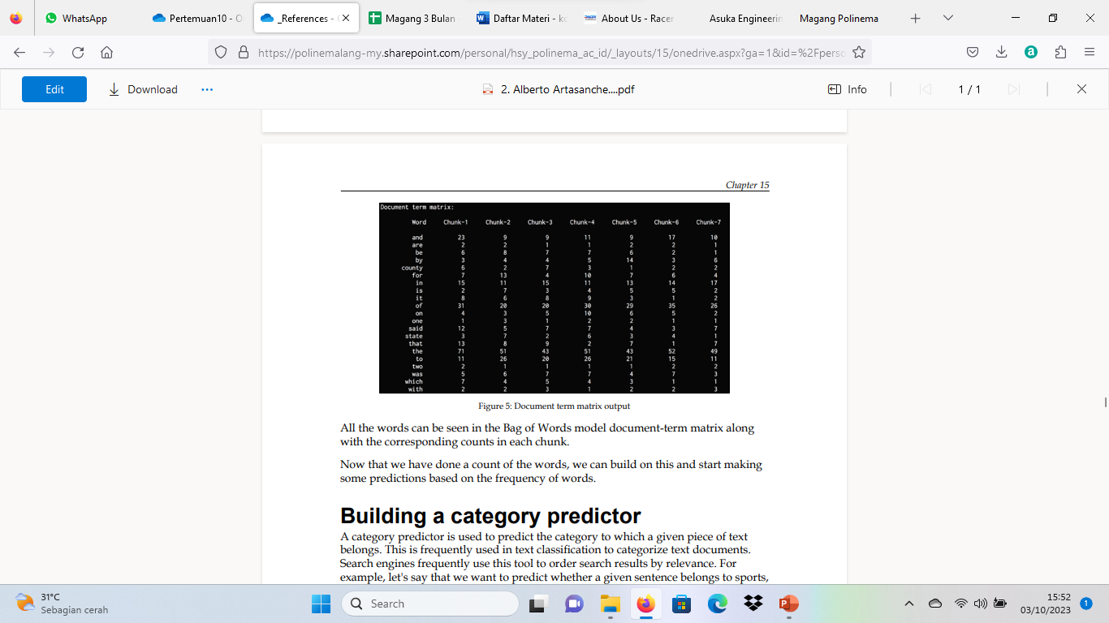
Extracting the frequency of terms using the Bag of Words model
One of the main goals of text analysis with the Bag of Words model is to convert text into a numerical form so that we can use machine learning on it. Let's consider text documents that contain many millions of words. In order to analyze these documents, we need to extract the text and convert it into a form of numerical representation.
Machine learning algorithms need numerical data to work with so that they can analyze the data and extract meaningful information. This is where the Bag of Words model comes in. This model extracts vocabulary from all the words in the documents and builds a model using a document-term matrix. This allows us to represent every document as a bag of words. We just keep track of word counts and disregard the grammatical details and the word order.

Slide 16
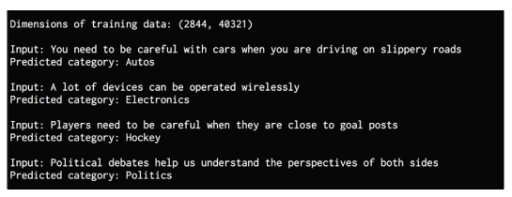
Building a category predictor
A category predictor is used to predict the category to which a given piece of text belongs. This is frequently used in text classification to categorize text documents. Search engines frequently use this tool to order search results by relevance. For example, let's say that we want to predict whether a given sentence belongs to sports, politics, or science. To do this, we build a corpus of data and train an algorithm. This algorithm can then be used
In order to build this predictor, we will use a metric called Term Frequency – Inverse Document Frequency (tf-idf). In a set of documents, we need to understand the importance of each word. The tf-idf metric helps us to understand how important a given word is to a document in a set of documents. for inference on unknown data.

Slide 17
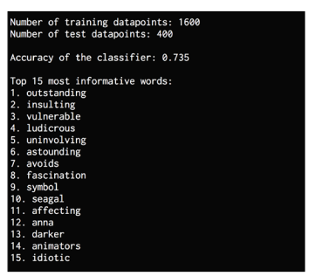
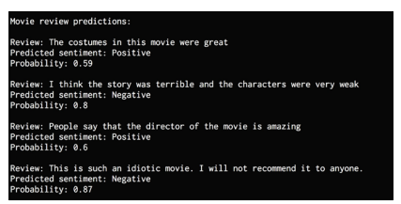
Building a sentiment analyzer
Sentiment analysis is the process of determining the sentiment of a piece of text. For example, it can be used to determine whether a movie review is positive or negative. This is one of the most popular applications of natural language processing. We can add more categories as well, depending on the problem at hand. This technique can be used to get a sense of how people feel about a product, brand, or topic. It is frequently used to analyze marketing campaigns, opinion polls, social media presence, product reviews on e-commerce sites, and so on. Let's see how to determine the sentiment of a movie review. We will use a Naive Bayes classifier to build this sentiment analyzer. First, extract all the unique words from the text. The NLTK classifier needs this data to be arranged in the form of a dictionary so that it can ingest it. Once the text data is divided into training and testing datasets, the Naive Bayes classifier will be trained to classify the reviews into positive and negative. Afterward, the top most informative words to indicate positive and negative reviews can be calculated and displayed. This information is interesting because it shows what words are being used to denote various reactions.

Slide 18


Thank you

